Slide 1


On-Farm Data Collection Tools for the PSA Research Network
PSA Data Flow Team
January 2020
Sarah Seehaver Eagen

Slide 2
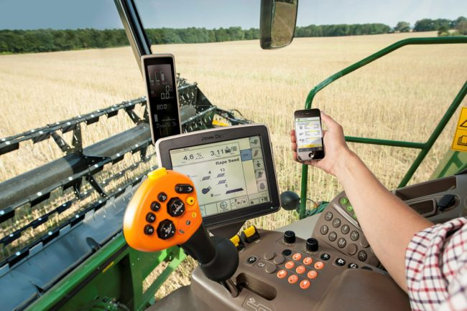
Large on-farm networks are powerful, but hard
Multiple management strategies over huge areas
Greater power to build predictive tools across climates and challenge scenarios
But they are hard:
Communicating same protocols
Onboarding new researchers
Same data collection strategies, naming, etc.
Errors in data entry multiply on a large scale
Easy to lose quality control

Slide 3
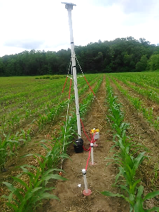

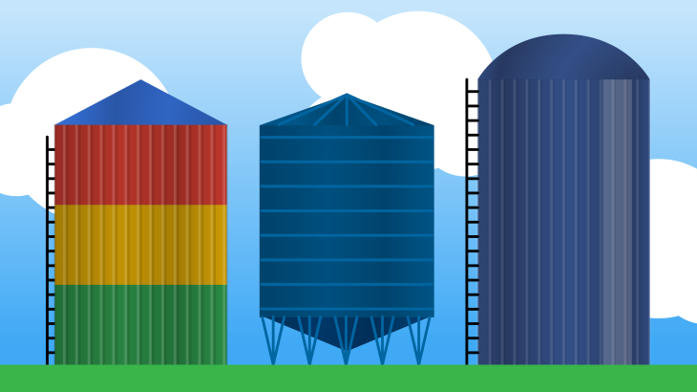
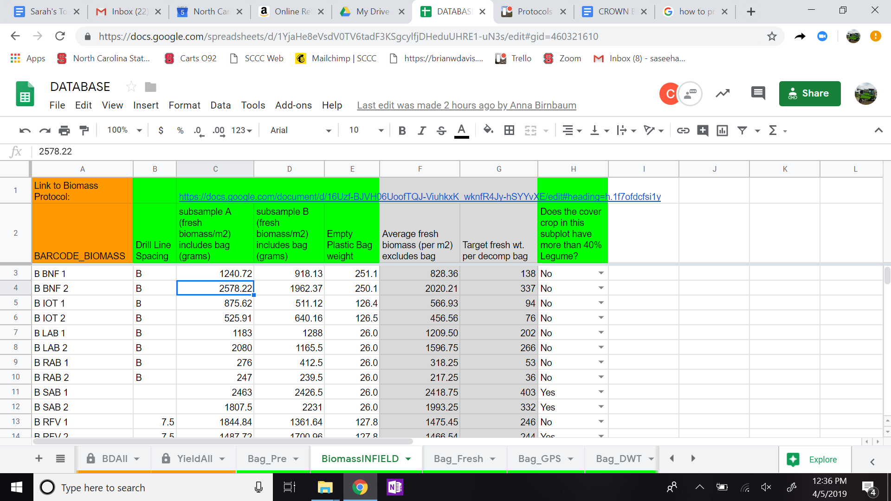
“Old-Fashioned” Research Data Collection Model
Data Collection via Tech (Sensors)
Data Collectors via Field Technicians
Data Silos
Publications, Journals
Thesis
Meta analysis
Extension bulletin
Spreadsheets

Slide 4
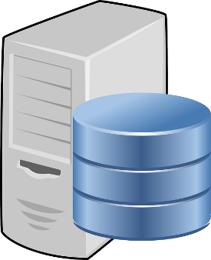

More Modern-ish Data Collection Model
Data Collection via Tech (Sensors)
Data Collectors via Field Technicians
Data Visualization, Public Websites and Apps
Database
Spreadsheets

Slide 5
Modern Data Collection Problems
Data Collection via Tech (Sensors)
Data Collectors via Field Technicians
Data Visualization, Public Websites and Apps
Database
Spreadsheets
Entry Error, protocol misunderstanding or update, misspelling, accidental deletion, etc…
If any data input doesn’t match expected, it won’t go into the Database

Slide 6
Online Spreadsheets Disadvantages 3 years in the field with spreadsheets, 100+ farms… what we’ve learned…
Year 1: Laptops awkward in the field; access to internet problem
Year 2: Errors in columns, or data inputs are not expected values, data won’t go in database
Year 3: Multiple users offline Google sheets can delete data
Spreadsheets alone Confusing in large groups: not sure if data is filled correctly, many tabs, hard to onboard new people, hard to remember protocol…
Too many tabs
Notes:
Reasons why it’s hated:
Year 1: We learned awkward in the field, where people preferred paper to a keyboard
Year 2: We learned that if you don’t lock the input for farm code, no data will fit in database. Can allow for unlocked editing different than tables in a database
Year 3: We learned, when multiple users are involved on and offline, Other people can delete or edit your data
Not always fully completed, so no data visuals
Doesn’t know when it’s not filled correctly. Technicians are manually asked to redo their datasheets
Many confusing tabs when onboarding new people and protocols

Slide 7

Stepwise PSA approach to upgrading on-farm data ‘From Paper to Database’
First step – an online datasheet like Google Sheets or Airtable
Next step – a Form Survey based collection
Ie: Google Forms
ODK
Kobo Toolbox
Future Custom Apps – Web tools

Slide 8
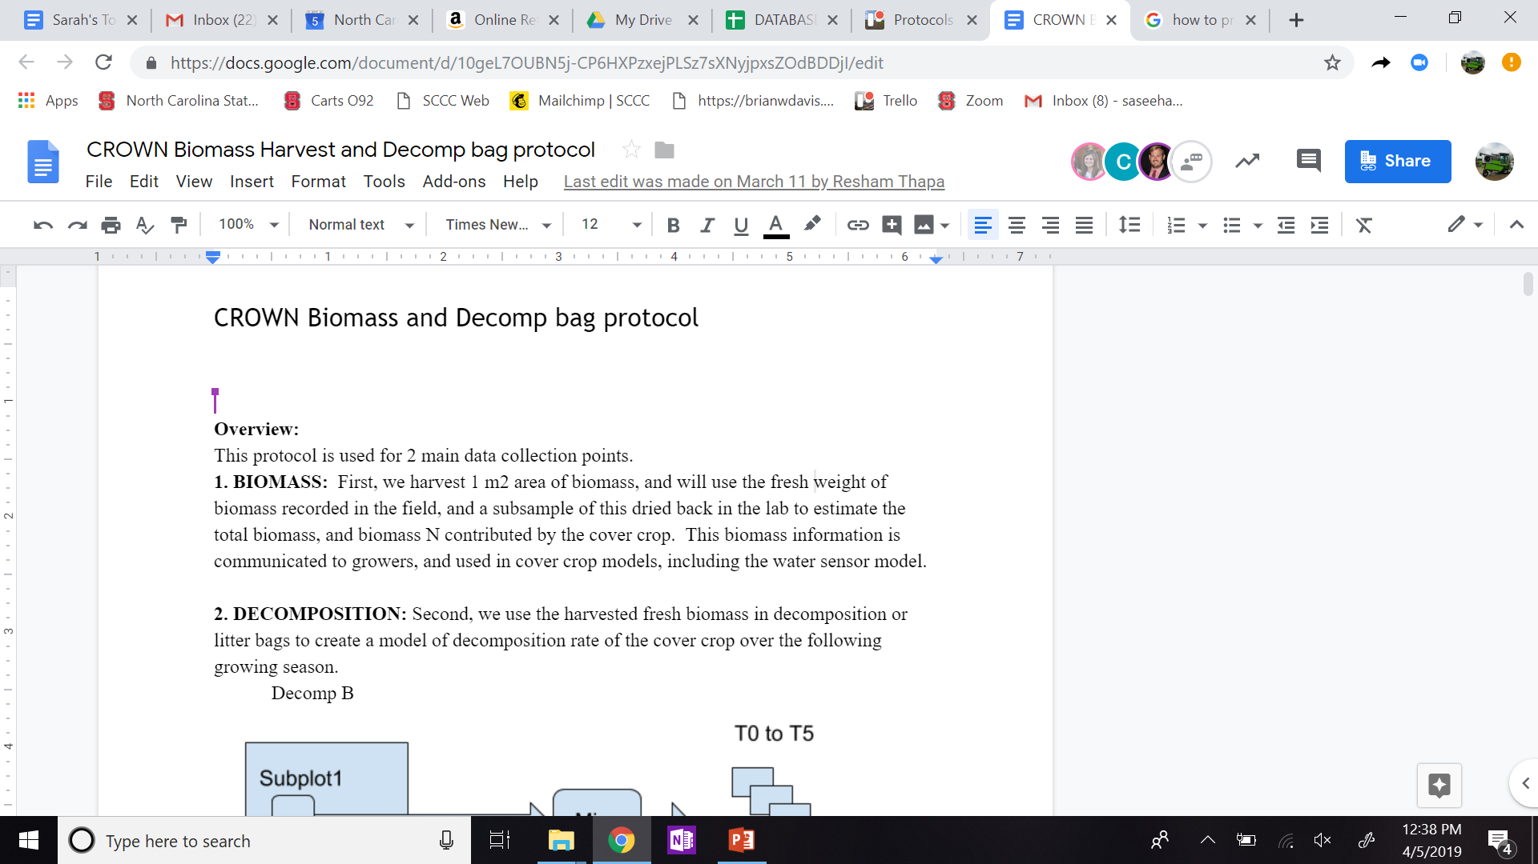
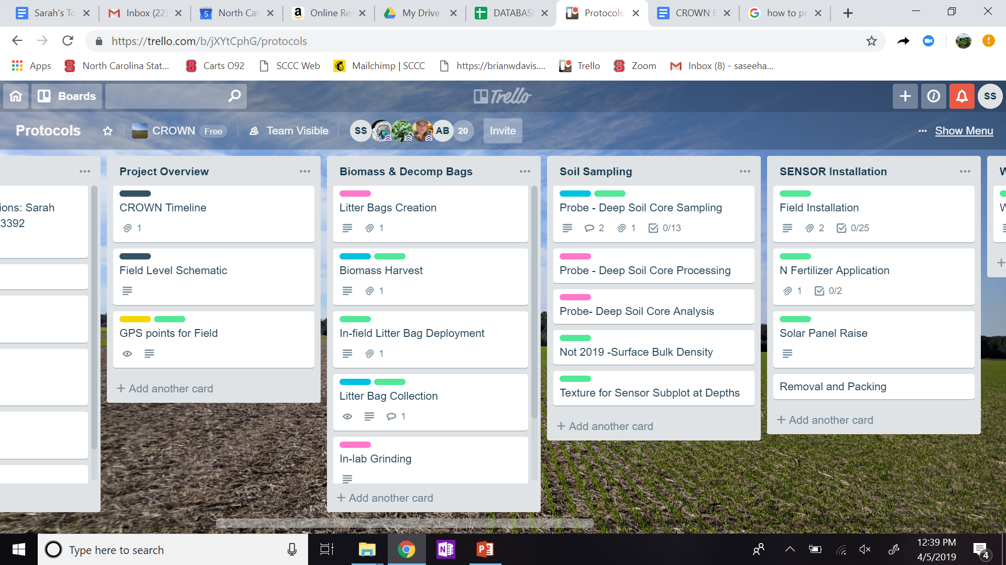

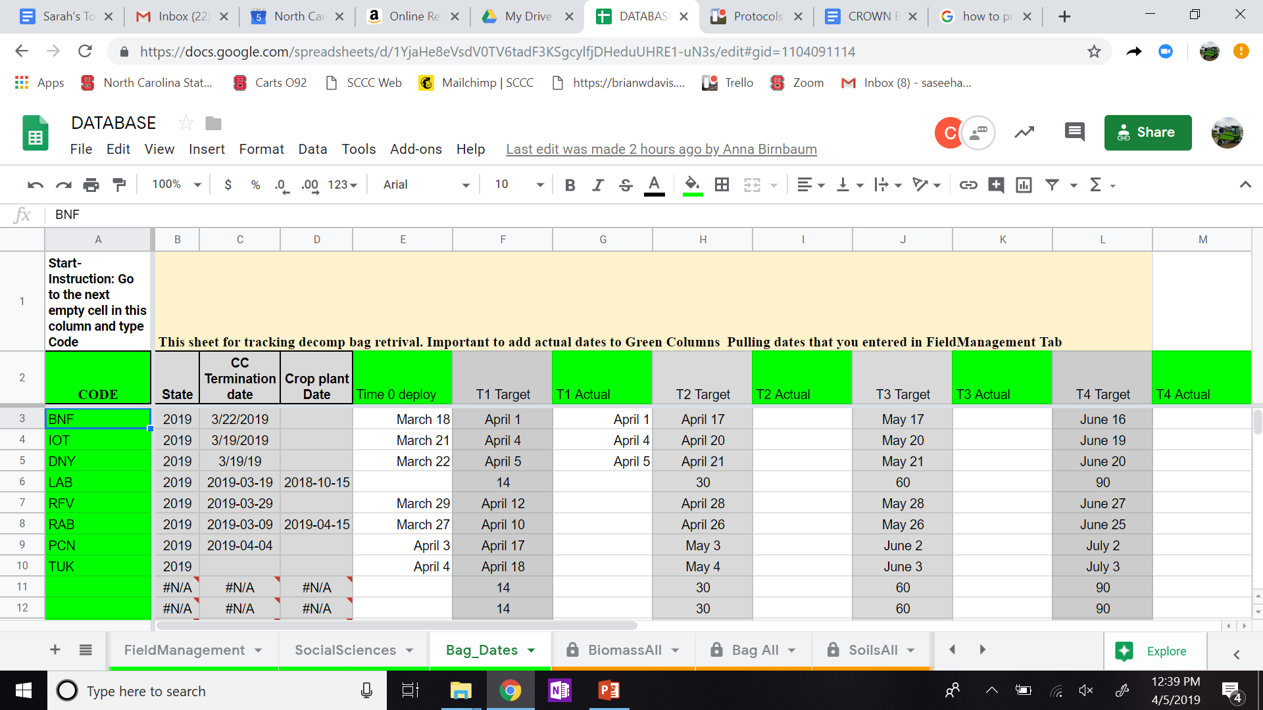
Turn These Project Complexities…
Protocols
(Stored in a folder, google drive, paper…)
Timeline
(Trello, Calendar Apps, email reminders)
Datasheets
(Google Sheets)
Calculations
(other Google Sheets)

Slide 9

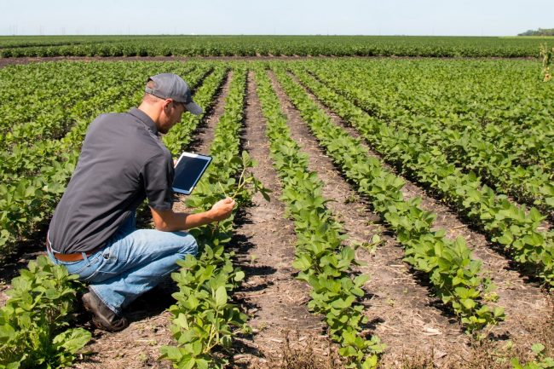
…Into Paperless Offline Forms using ODK
ODK: Open Data Kit
Free, Open Source, online form builder for collecting data
Creates stepwise logic questions to fill data
Think your column headers in excel
User chooses type of data
ie: multiple choice question, number, barcode, geospatial, etc
Embedded protocols with step-by-step instruction
No missing points with required entry and validation
Syncs data, when device returns online, directly into a database

Slide 10
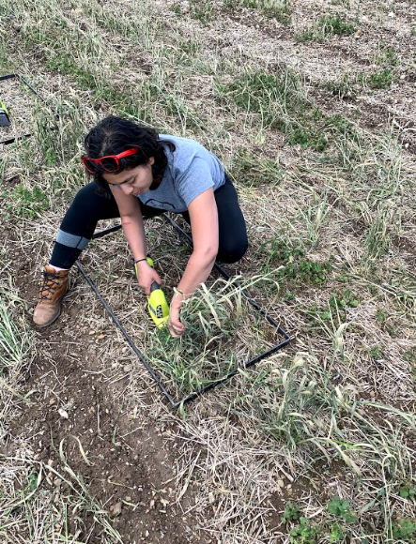
ODK is User Friendly and Highly Customizable
Perfect for in-bedding protocols
Onboarding new researchers
Can hide steps for more advanced users
Can cascade with if/ then logic
Makes calculations on the fly (for better flexibility and control)
Same data collection strategies, naming, etc.
Quality control on a large scale
Saves time with uniform formatting and transferring data for researchers

Slide 11

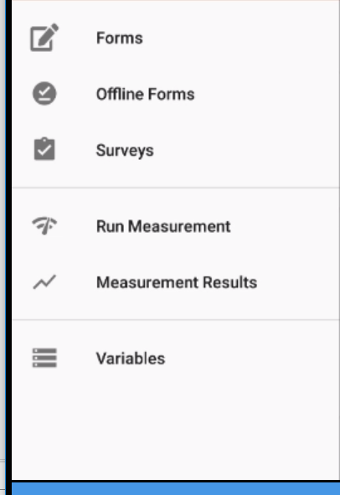
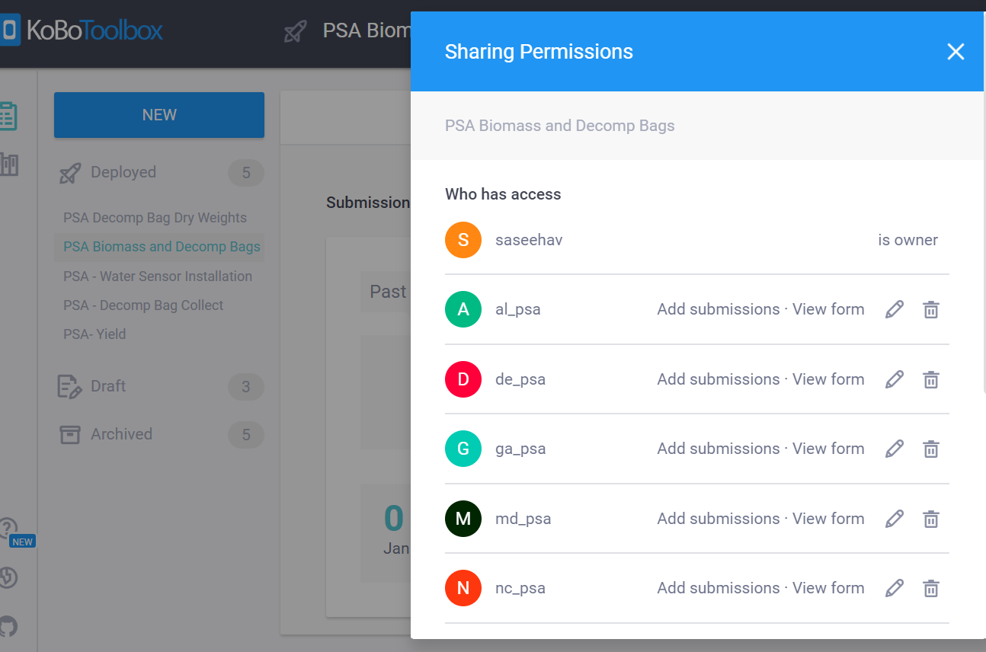
Export ODK form into Kobo Toolbox, for App based data collection
Share with network users
Protocol Manager creates a new Form, shares it with all users
Forms are uploaded to devices, are pushed updated forms when connected to WiFi, and can be used offline

Slide 12
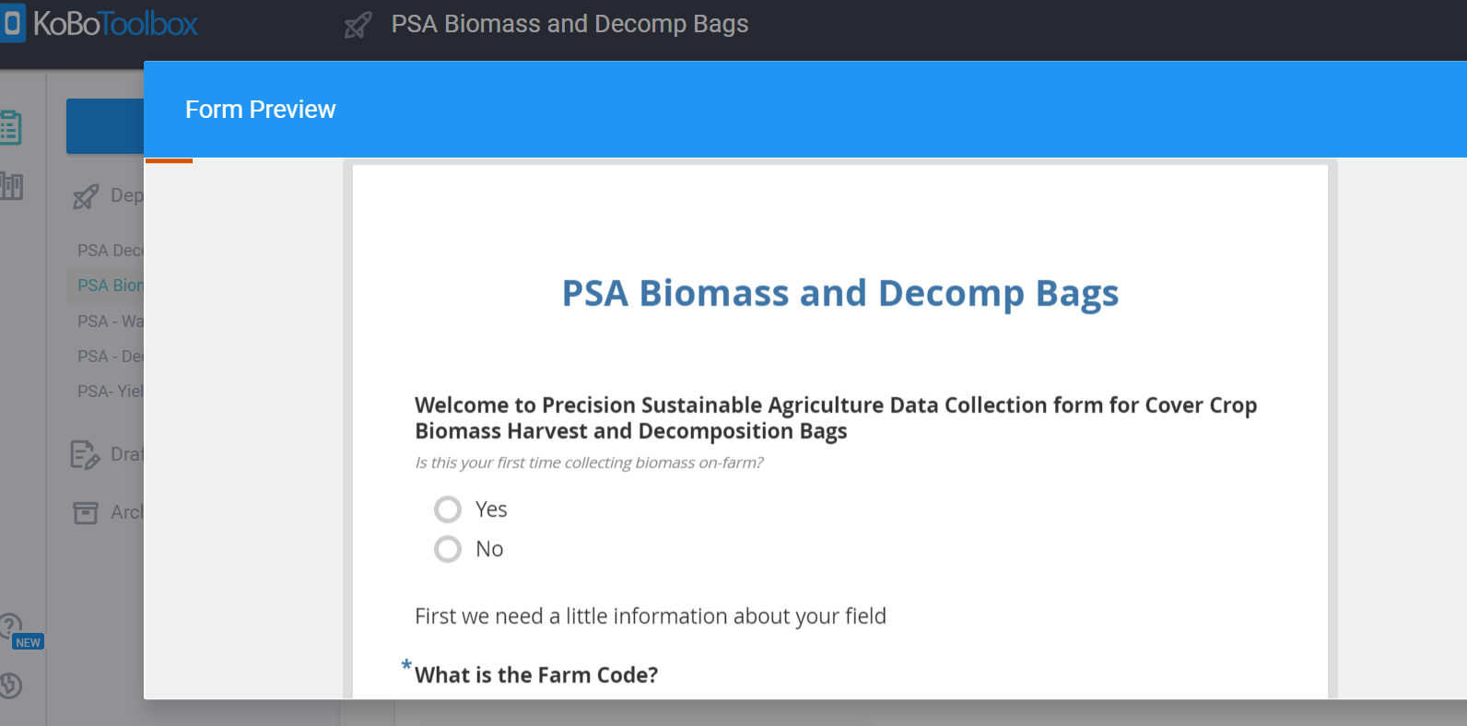
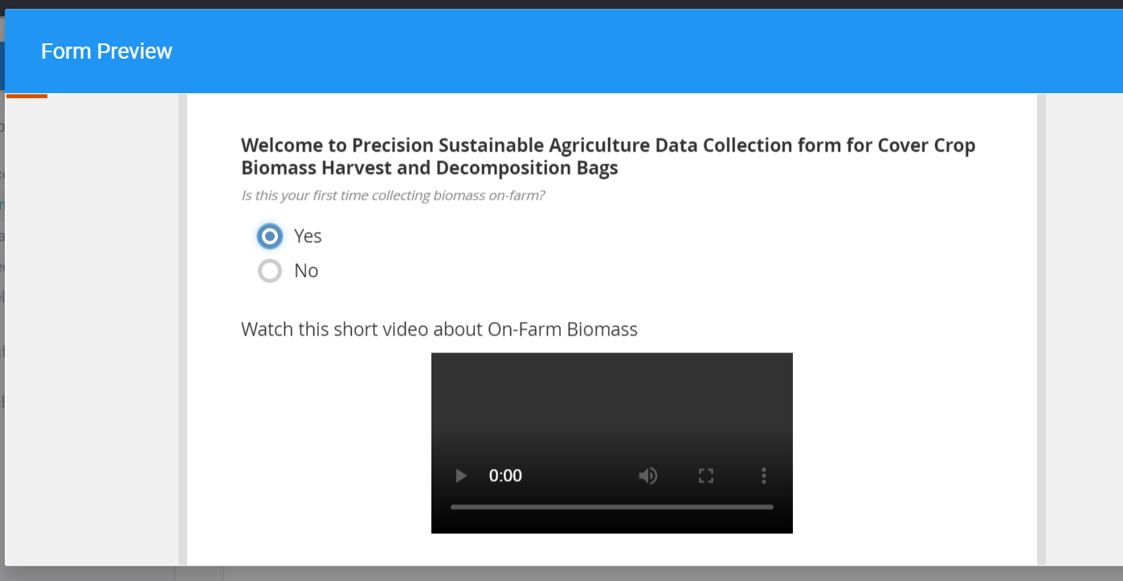
Example Protocol: Biomass Harvest and Decomposition Bags
Welcome. Are you a new user?
Cascading logic:
If Yes, an instructional video appears
If No, nothing

Slide 13
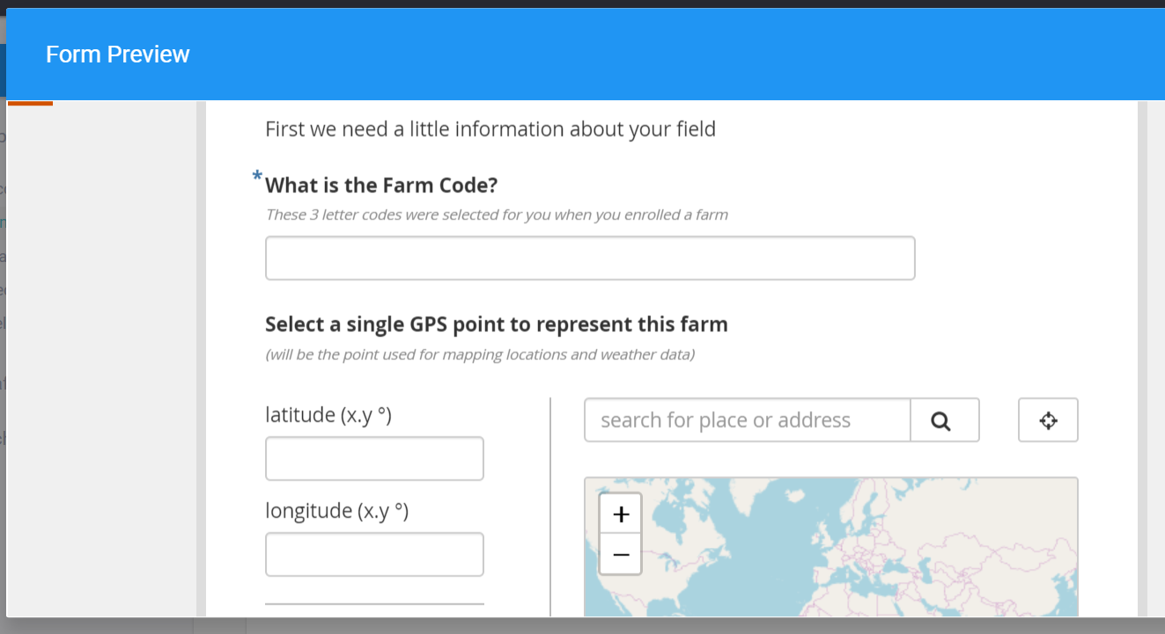
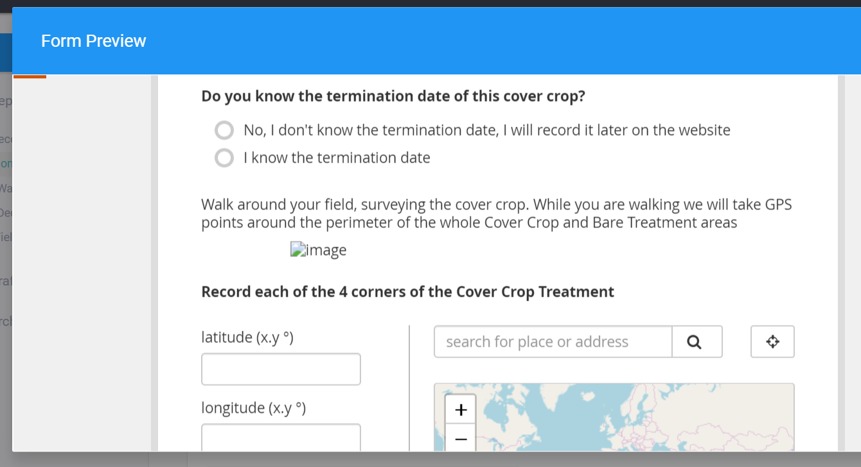
Example Protocol: Biomass Harvest and Decomposition Bags
Required Fields
Previously missed metadata
Easy GPS
PSA uses Standardized Farm Codes across whole network.
Great way to collect metadata while collecting samples.

Slide 14
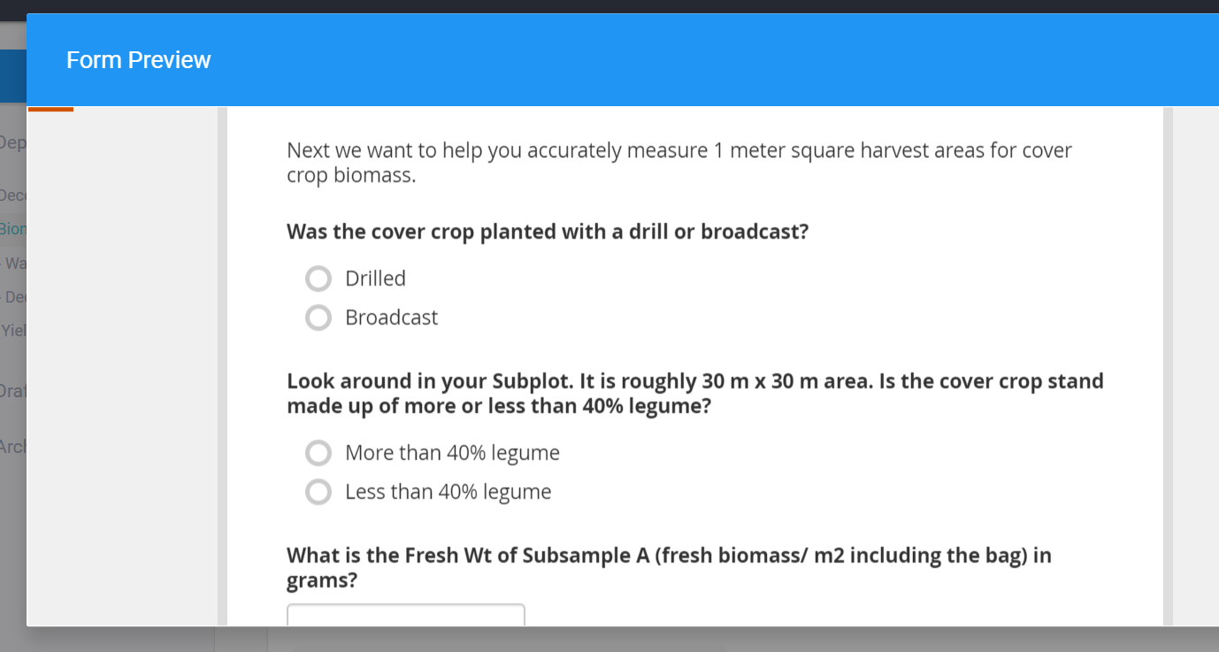
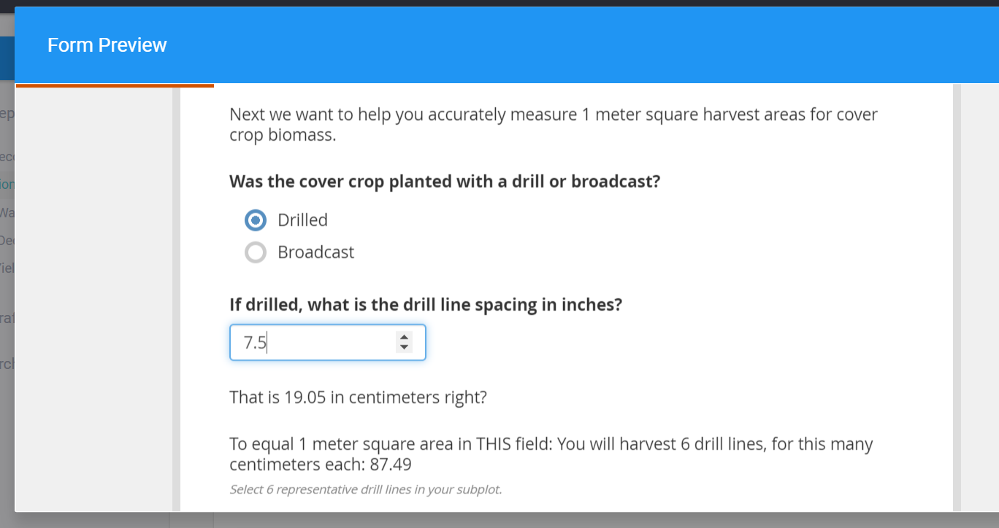
Example Protocol: Biomass Harvest and Decomposition Bags
Protocol Instructions
Customized harvest area according to unique field variables
If ‘Drilled’, goes into a calculation screen.
If ‘Broadcast’, a different set of instructions.
Calculations on the fly.
Gets rid of user error and simplifies database management.

Slide 15
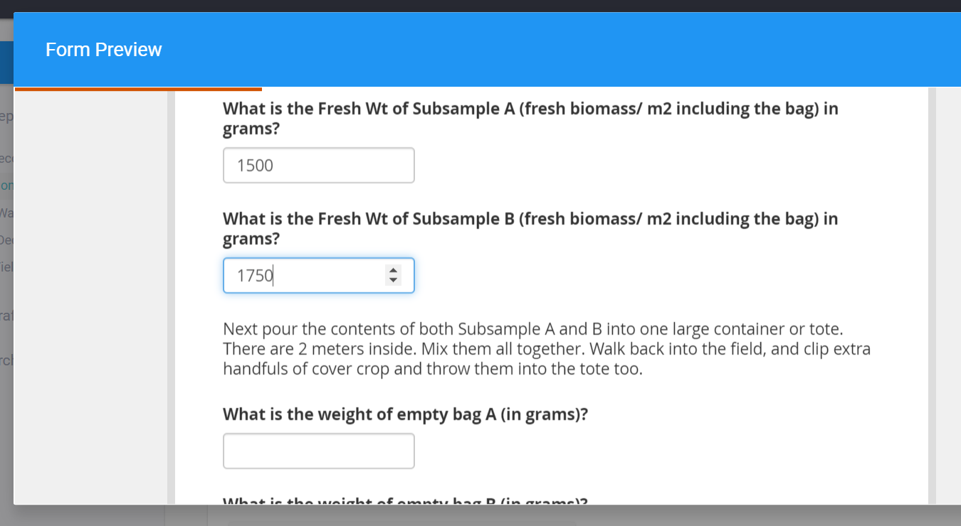
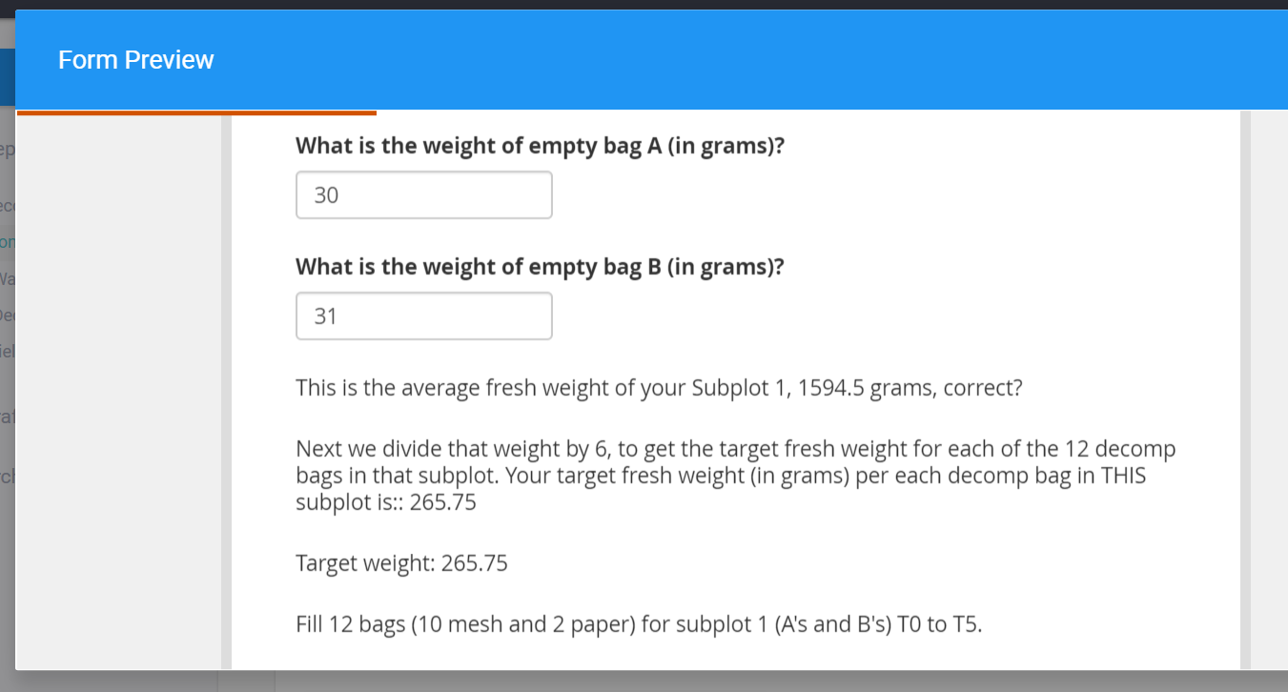
Example Protocol: Biomass Harvest and Decomposition Bags
Next: Enter Fresh Biomass Weights
Make calculations in the form
Enter Weights on number pad
This was formerly a 12 page protocol with a spreadsheet to make calculations

Slide 16
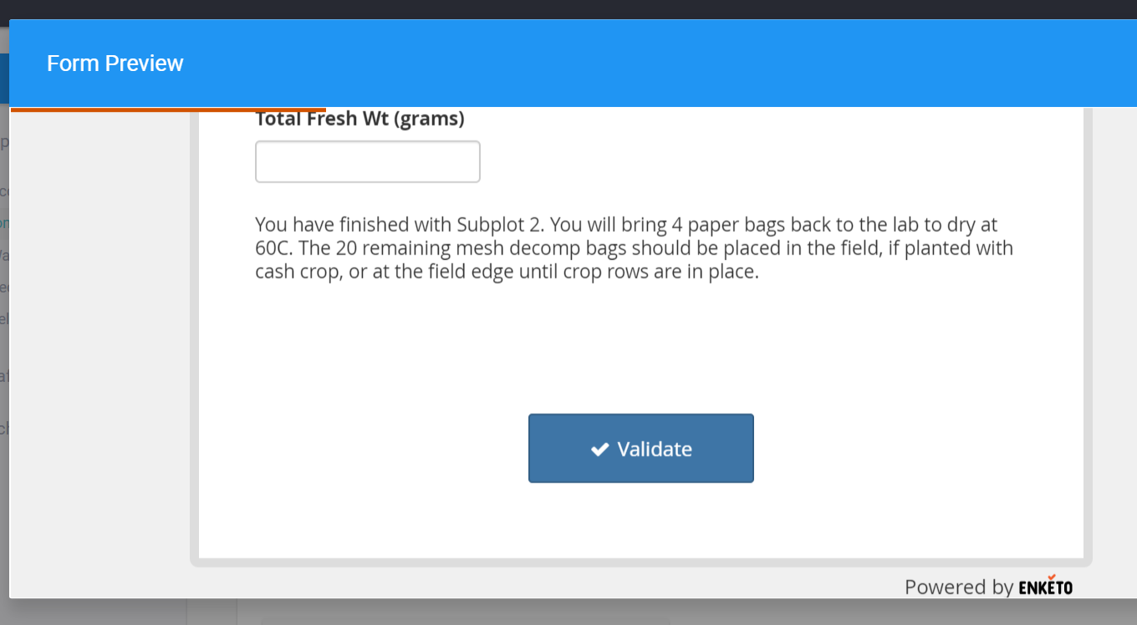
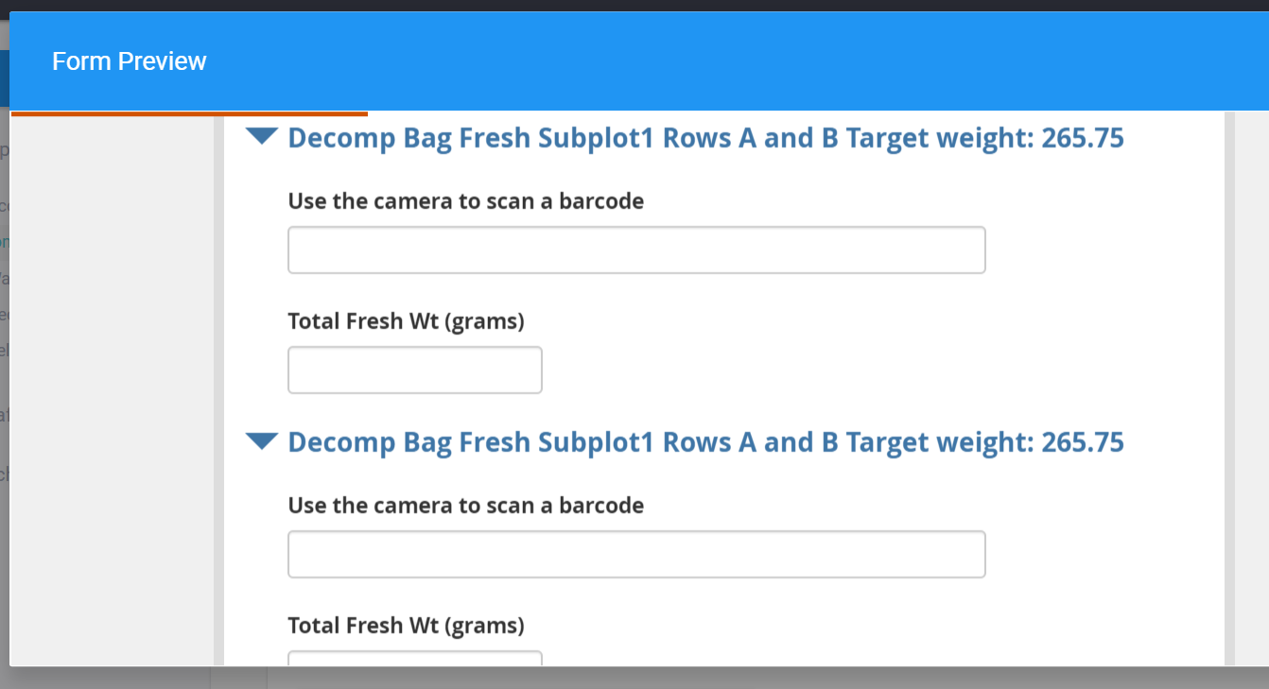
Example Protocol: Biomass Harvest and Decomposition Bags
Use tablet camera to scan barcode
Finish, and instructions for sample handling
Visual reminders of target wts
Barcodes: uniform PSA labeling system for samples in database
Data Validation, at end of form, before submission, to confirm no mistakes, missing data

Slide 17
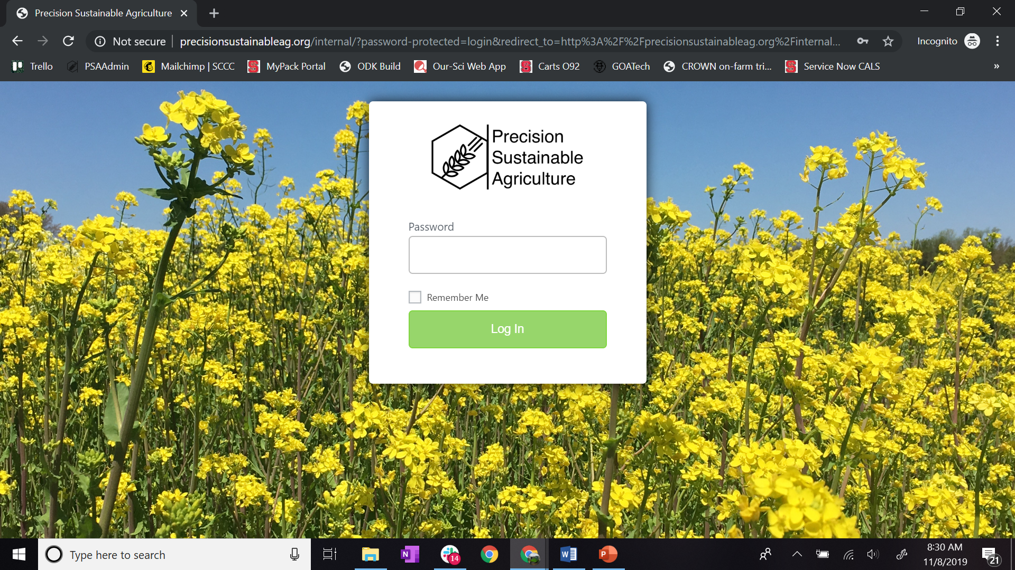
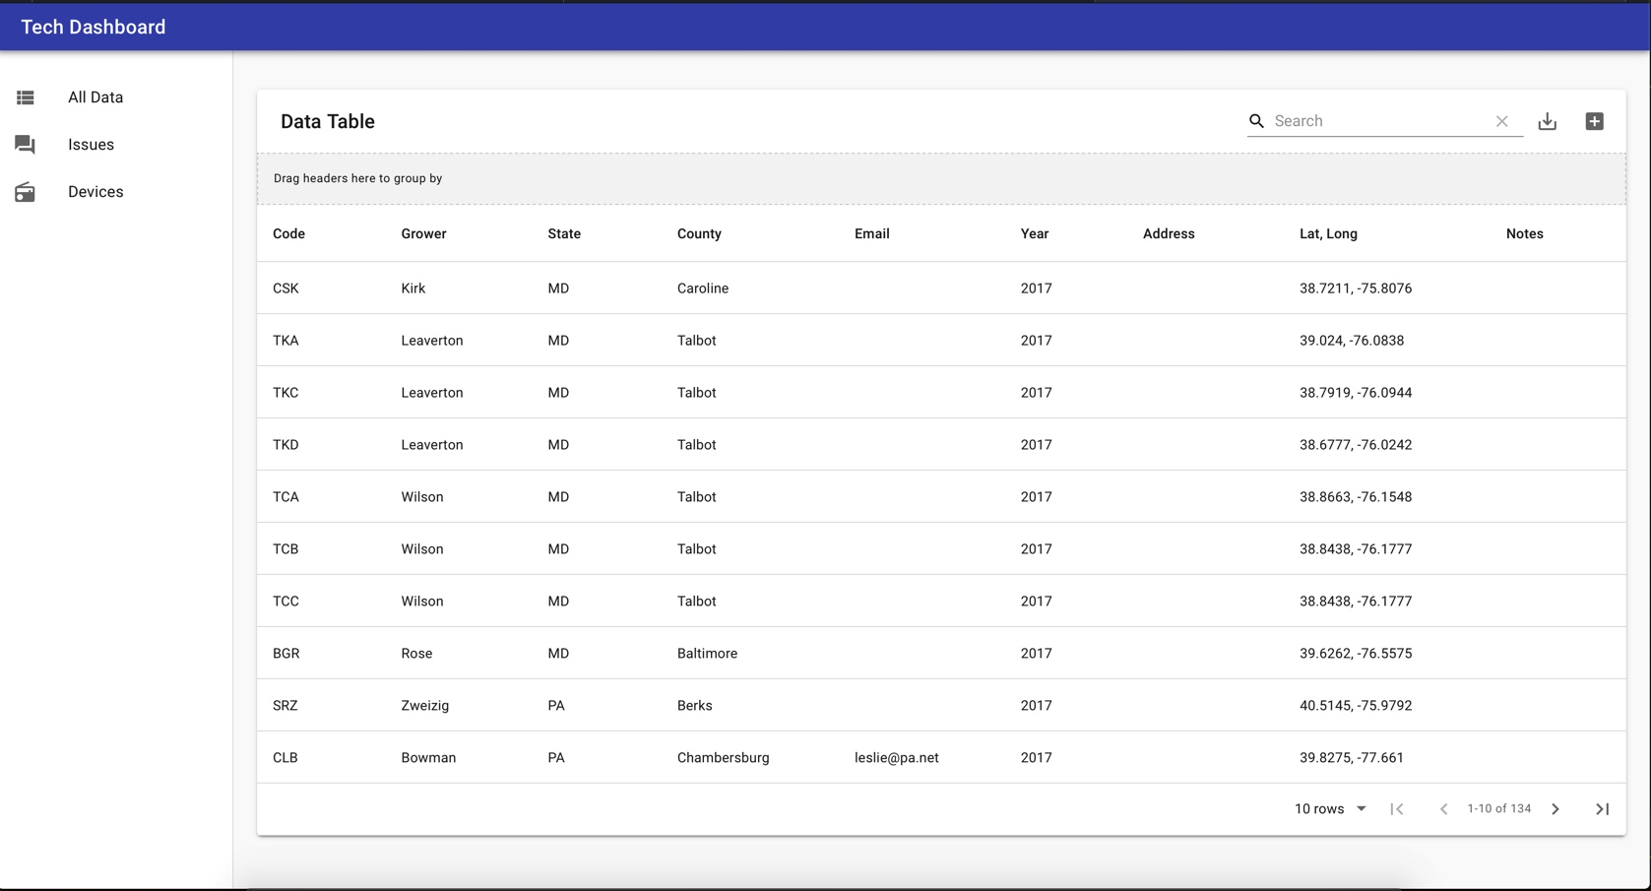
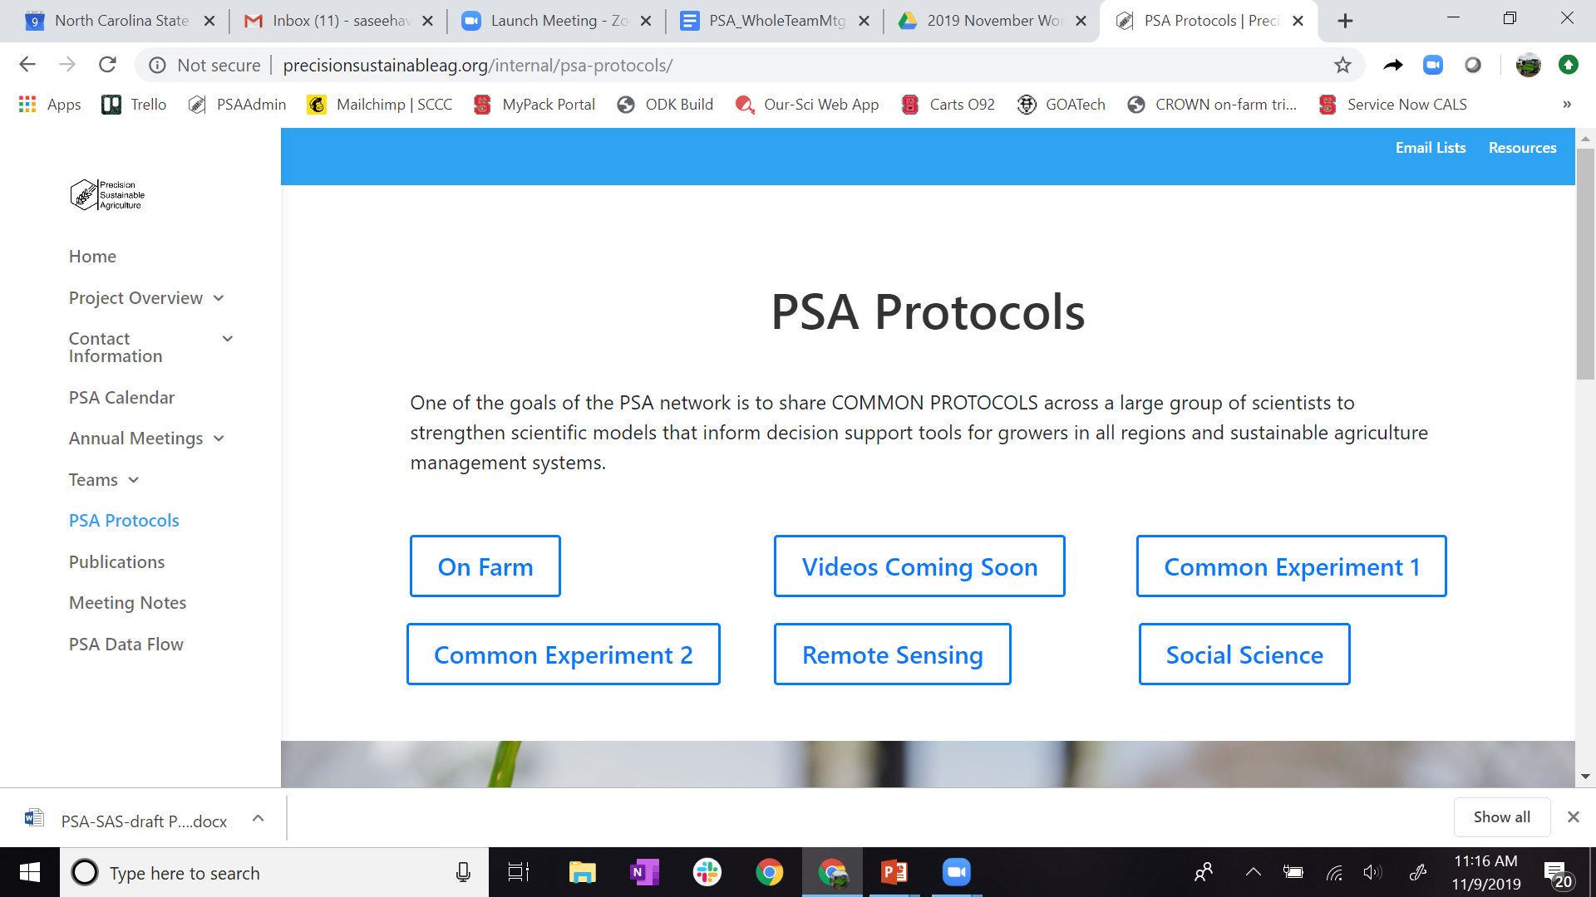
PSA Near Future - One web platform to rule all the tools
PSA Internal Web
“Tech Dashboard” to visualize the entered data and track technology devices working on cloud platforms
PSA offers a “Data Flow Team” to service the network
On-Farm team gives feedback as beta testers for newer protocols
On-Farm “How-To” Video Clips, PSA YouTube Channel: https://www.youtube.com/channel/UC4ZHzMlyh8WezIWcFdt5gwQ/playlists
Internal PSA website
Tech Dashboard
Login

